Slide 1
Budget 2018-19
Kick-off Session
-1 Assam State Public Finance Institutional Reforms (ASPIRe) Project
01st Dec, 2017
Finance Department
Government of Assam

Slide 2



Philosophy of Budget 2018-19
Partnership with Departments
Technology to support
Budget Transparency to increase

Slide 3
Agenda
Background: Public Finance Reforms
Rationale to Proposed changes: Budget 2018-19
Changes introduced: Budget 2018-19
  Electronic Budget
  Outcome & Sectoral Budgets
  Other key procedural changes
Budget Review Meeting schedule
Support from Finance Department

Slide 4
Background : Public Finance Reforms
-1 Background and Scope of Work
Major Transformation in Public Finance Management in the last 20 months
End of Planning Commission and State to Plan & Prioritize
Central Taxes devolution increased to 42% from 32%
Restructuring & rationalization of Centrally Sponsored Schemes
Plan, Non-Plan distinction removed; Expenditure classified as Revenue, Capital
Reforms agenda being driven in Finance Department
ReSTART Assam
  Assam State Public Finance Institutional Reforms (ASPIRe) Project
  Lead Externally Aided Projects (LEAP) Cell
Assam Public Procurement Act, 2017 (Draft rules circulated to Departments)
Online Budget Preparation & Distribution
Online Ceiling Proposal to the DDOs
Online Salary Bill (now covers almost 95% of DDOs)
First Salary Module (now rolled out)
Online Non-Salary Bills (now being piloted)

Slide 5
Rationale to proposed changes: Budget 2018-19
-1 Background and Scope of Work
In continuation with the efforts towards Public Finance reforms, we are introducing new initiatives in Budget 2018-19 aimed to:
  ‘Reduce the Data-entry’ effort at the HoD/ Department levels
  ‘Limit the mis-classifications’ of Receipt/ Expenditure Heads
  ‘Shorten the Budget preparation’ cycle-time
  ‘Rationalize the Expenditure Heads’ of Accounts
  Capture the expenditure planned under ‘Appropriate Budgetary classifications’ (Gender) & bring Outcome focus to Budget (SDG)
  Optimise use of ‘Cash & Debt’ by the State Government
  Increase ‘Budget Disclosures’ as part of Transparency initiatives
  Build ‘Database of Key Assets’ of the State

Slide 6
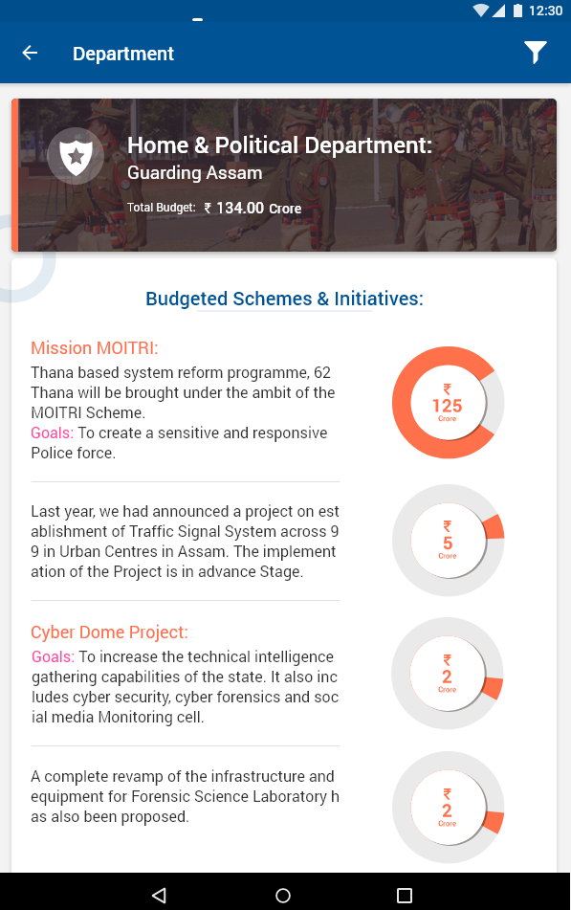
Electronic Budget
-1 Background and Scope of Work
Mobile App to be created for Budget 2018-19; can be subsequently extended for Expenditure monitoring
Printing of Budget Books to be cut down
Hon’ble MLAs, Senior Officers to be given pre-loaded tablets for the same
Media, Departments to be given pre-loaded Pen-drives
Citizens to download from Google Playstore, Apple Store
Budget speech ‘search function’ to be enabled for Citizens to search for concerned topics, schemes (eg: Tea, Rural Infrastructure, Students etc.)

Slide 7

Outcome Budget
-1 Background and Scope of Work
Outcome Budget (Sustainable Development Goals)
Outcome Budget aligned to SDGs, process of mapping specific Goal, Target to Head of Account improved over last year
Supported by SDG Cell, Finance Department has trained 12 Departments in the revised mapping process
Other Departments to be given training over the next couple of weeks

Slide 8
Sectoral Budget
-1 Background and Scope of Work
Sectoral Budget
In addition to Gender Budget, the State Government is introducing the concepts of Child/ Girl Child Budget, Elderly Budget and Divyang Budget
Allocations under various schemes for the above categories should be clearly reflected in the budget document to improve transparency in public spending
Facility created on FinAssam portal to specify the budget earmarked for the appropriate category, while submitting Expenditure
Only affirmative actions of the State/ Positive Discrimination by the State should be earmarked under a particular category of Sectoral Budget
Note: Child is defined as being between 0-14 years of age

Slide 9
Sectoral Budget (Examples)
-1 Background and Scope of Work
Case 1
Type: Exclusively meant for a particular category
Category: Divyangs
Example: Special ITIs for Divyangs,
Tagging: 100% of the Budget of the scheme under Divyang category
Case 2
Type: X% of the scheme mandatorily earmarked for a particular category
Category: Elderly
Example: Assuming PMAY(R) guidelines say 10% houses for Elderly
Tagging: 10% of the Budget of the scheme under Elderly category

Slide 10
Sectoral Budget (Examples)
-1 Background and Scope of Work
Case 3
Type: Scheme where benefits given to multiple categories
Category: Benefits multiple categories
Example: Children Education Scholarship, where 50% for Girl children
Tagging: 100% under Child Budget, 50% under Girl Child Budget
Case 4
Type: Policy benefitting a particular category
Category: No specific budget, but a policy/ Law benefiting a particular category
Example: Assam Employees’ Parent Responsibility and Norms for Accountability & Monitoring Act, 2017
Tagging: To be tagged in Budget Speech writing section on FinAssam

Slide 11
Sectoral Budget (Examples)
-1 Background and Scope of Work
Case 5
Type: General Scheme where benefits given as per the ratio of population
Category: Benefits everyone
Example: National Urban Livelihood Mission, where Women, Divyang both probably benefit in the ratio of their population in the State
Tagging: No tagging of the Budget under any of the categories
Rationale: Only positive discrimination of State to be mapped. Also, in general schemes, it is not guaranteed that benefits will accrue in population ratio

Slide 12
Key changes introduced (1/7)
-1 Background and Scope of Work
Reduce Data-entry efforts
All form, annexure, Budget Speech entry on FinAssam only
2016-17 Actuals, 2017-18 RE pre-populated for HoDs, Departments
"L Forms" of employees who draw Salaries under Detail Head "01" to be auto-populated (except for Grants 76-78) for DDOs to verify & approve (Online Salary Bill)
  L forms under “02” by DDOs (Deadline: 12 December)
  L forms under 31-GIA to be submitted by HoDs/ Depts

Slide 13
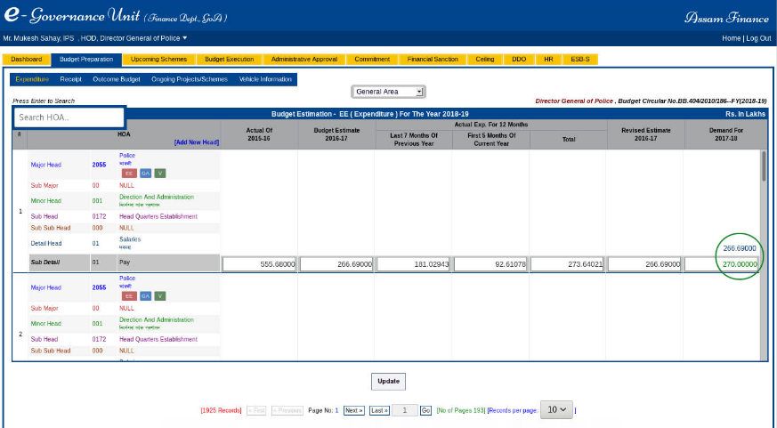
Key changes introduced (2/7)

Slide 14
Key changes introduced (3/7)
-1 Background and Scope of Work
Limiting mis-classifications
Receipt Budget: System assisted controls limiting the use of Minor Head “800 – Others”, and the creation of Sub-Head, Sub-sub-Head for capturing detailed information on different types of revenues
Expenditure Budget: Limiting use of Minor Head “800 – Others”, Detailed head “26-Other Charges” or Sub detailed head “99 –Others”‘
System assisted controls for Revenue vs Capital & Establishment vs Development classifications (except 35- GIA for creation of Capital Assets)

Slide 15
Key changes introduced (4/7)
-1 Background and Scope of Work
Rationalize the Expenditure Heads
Collaborate with the Departments/HoDs to rationalize the Budget Head of Accounts where no expenditure has been recorded (>5000 Detail Heads)
System assisted controls to justify increase in Budget against a HoA of >10% over 2017-18 Revised Estimates
Optimise use of ‘Cash & Debt’ by the State Government
Arrears in Revenue collection along with the Collection Plan
Quarter-wise Expenditure Plan against each Head of Account

Slide 16

Key changes introduced (5/7)
-1 Background and Scope of Work
Appropriate Budgetary classifications
As part of Budget Preparation efforts, expenditure to be automatically classified, under Establishment/ Development, Revenue/Capital categories
Secretariat level expenditure (Non-Salary) for all administrative departments shall be reflected under the demand for grants of the respective departments

Slide 17
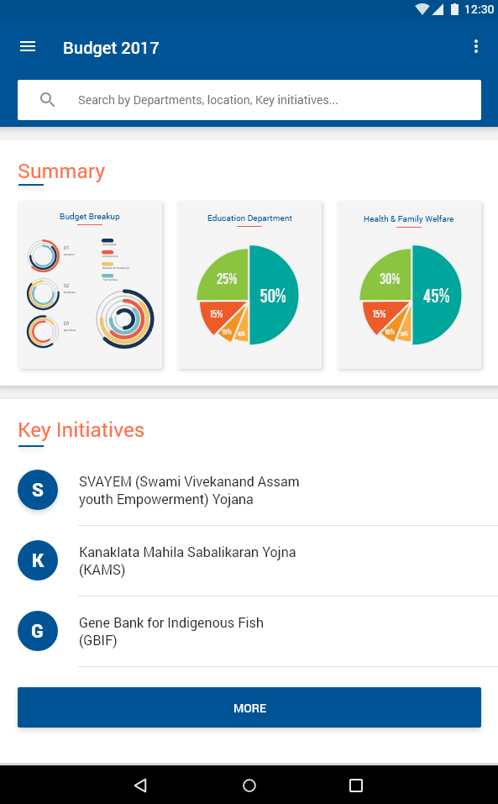
Key changes introduced (6/7)
-1 Background and Scope of Work
Budget Disclosures
Status of Implementation of Budget Announcements of 2016-17, 2017-18 (As on Dec 31st, 2017)
Database of Key Assets
DDO/ HoD to submit list of currently available owned Vehicles (Working, Under Repair, To be condemned) – deadline for DDO is Dec 30th
DDO/ HoD to submit list of Projects initiated where AA has been given, work started but not completed – deadline for DDO is Dec 30th

Slide 18
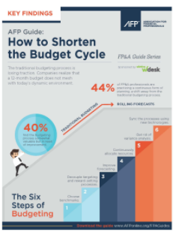
Key changes introduced (7/7)
-1 Background and Scope of Work
Shorten the Budget Cycle
Budget Kick-off on Dec 1st, Last date for Expenditure, Receipt submission on Jan 08th (Scrutiny, Finalization by Jan 27th)
Detailed timelines are mentioned in page 18 of the Budget Guidelines 2018-19

Slide 19
Budget Review Meeting Schedule
Review Meetings will be held every Tuesday and Friday at (1.30 PM & 3.30 PM) in 4 groups starting from 4th December till 12th January, 2018 to monitor the Budget Preparation Process
Attendees: Nodal Officers of the Administrative Departments/ HoDs (Sr. FAs/ FAs of the Administrative Department along with the Sr. FAOs / FAOs of the HoD, in addition to any other officer that the Department/ HoDs may designate)
Venue: Finance Department Conference Hall, Ground Floor
Note: 1st Meeting of Groups 3, 4 will be held on 4th Dec, Monday @ 1.30 PM & 3.30 PM respectively. Subsequent meetings for Groups 3, 4 to be held every Friday

Slide 20
Support from Finance Department
Weekly interaction with the concerned Departments/ HoDs
Hands-on training at the Finance Department Training Hall
  Any day of the week, any time
Technical staff placed at each Treasury/ Sub-Treasury for any technical assistance to the DDOs
Budget Helpdesk: helpdesk.budget@afegu.in
Budget Cell established in the Finance Department for assistance to the Departments, HoDs

Slide 21
Thank You!
Alone we can do so little. Together we can do so much.

